Slide 1

Δv = ΔV_{max}cos( ωt)
C
V_{C}

Slide 2
Resistor in an AC Circuit
ΔV_{max}
Δv_{C}(t)
I_{max}
t
T
- I_{max}
i(t)

Slide 3
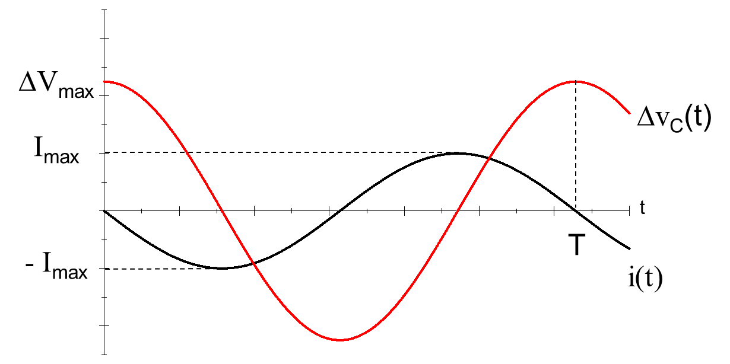
ΔV_{emf} = Δv_{C}
Δv_{C}
-
+
-
+
-
+
-
+
-
+
C

Slide 4
ΔV_{emf} < Δv_{C}
I
Δv_{C}
-
+
I
-
+
-
+
C

Slide 5
ΔV_{emf}
I
Δv_{C} = 0
I
C

Slide 6
ΔV_{emf} > Δv_{C}
I
Δv_{C}
-
I
+
-
+
C

Slide 7
ΔV_{emf} = Δv_{C}
Δv_{C}
+
-
+
-
+
-
+
-
+
-
C

Slide 8
ΔV_{emf} < Δv_{C}
I
Δv_{C}
-
+
I
-
+
-
+
C

Slide 9
Capacitive Phasor Diagram
t
I_{max}
ΔV_{max}
ωt
Δv, i

Slide 10

Diode
C
R
Alternating
Current Source

Slide 11
AC to DC conversion

Slide 12
“Dirty” DC current

Slide 13
Filtered DC Current

Slide 14
Δv_{out}/ Δv_{in}
1
R
Δv_{in}
C
Δv_{out}
log(ω)

Slide 15
R₁
Δv_{in}
R₂
Δv_{out}

Slide 16
Δv_{out}/ Δv_{in}
1
C
Δv_{in}
R
Δv_{out}
log(ω)

Slide 17
Capacitive Phasor Diagram
ΔV_{R}
t
I_{max}
ωt
Δv, i

Slide 18
Capacitive Phasor Diagram
t
I_{max}
ΔV_{C}
Δv, i

Slide 19
Capacitive Phasor Diagram
t
I_{max}
Δv, i
ΔV_{L}

Slide 20
Capacitive Phasor Diagram
ΔV_{R}
t
I_{max}
ΔV_{C}
Δv, i
ΔV_{L}

Slide 21
Phasor Diagrams
t
ΔV_{max}
t = 0
φ
Δv
Δv, i

Slide 22
Phasor Diagrams
t
ΔV_{L}
ΔV_{R}
Δv, i
ΔV_{C}

Slide 23
Phasor Diagrams
t
ΔV_{L}
ΔV_{max}
ΔV_{R}
ΔV_{L} - ΔV_{C}
ψ
Δv, i
ΔV_{R}
ΔV_{C}

Slide 24
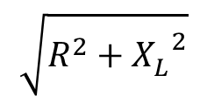

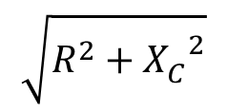






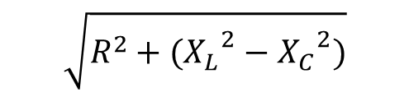
Circuit Elements
Impedance (Z)
Phase Angle (ψ)
$$R$$
0
$$XC$$
$$−\frac{π}{2}$$
$$XL$$
$$\frac{π}{2}$$
$$\sqrt{R^{2}+{X_{C}^{}}_{}^{2}}$$
$$−\frac{π}{2}<ψ<0$$
$$\sqrt{R^{2}+{X_{L}^{}}_{}^{2}}$$
$$0<ψ<\frac{π}{2}$$
$$\sqrt{R^{2}+({X_{L}}_{}^{2}−{X_{C}}^{2})}$$
Negative if X_{C} > X_{L}
Positive if X_{C} < X_{L}

Slide 25
Chapter 32
Alternating Current Circuits
and Electromagnetic Waves

Slide 26
Lecture 26

Slide 27
AC Circuit
An AC circuit consists of a combination of circuit elements and an AC generator or source
The output of an AC generator is sinusoidal and varies with time according to the following equation
Δv = ΔV_{max} sin 2πƒt
Δv is the instantaneous voltage
ΔV_{max} is the maximum voltage of the generator
ƒ is the frequency at which the voltage changes, in Hz

Slide 28
Kirchhoff for AC
Recall that Kirchhoff’s rules come from

Slide 29
Ohm’s Law in an AC Circuit
rms values will be used when discussing AC currents and voltages
AC ammeters and voltmeters are designed to read rms values
Many of the equations will be in the same form as in DC circuits
Ohm’s Law for a resistor, R, in an AC circuit
ΔV_{R,rms} = I_{rms} R
Also applies to the maximum values of v and i

Slide 30
More About Resistors in an AC Circuit
The direction of the current has no effect on the behavior of the resistor
The rate at which electrical energy is dissipated in the circuit is given by
where i is the instantaneous current
the heating effect produced by an AC current with a maximum value of I_{max} is not the same as that of a DC current of the same value
The maximum current occurs for a small amount of time

Slide 31
rms Current and Voltage
The rms current is the direct current that would dissipate the same amount of energy in a resistor as is actually dissipated by the AC current
Alternating voltages can also be discussed in terms of rms values

Slide 32
Power Revisited
The average power dissipated in resistor in an AC circuit carrying a current I is

Slide 33
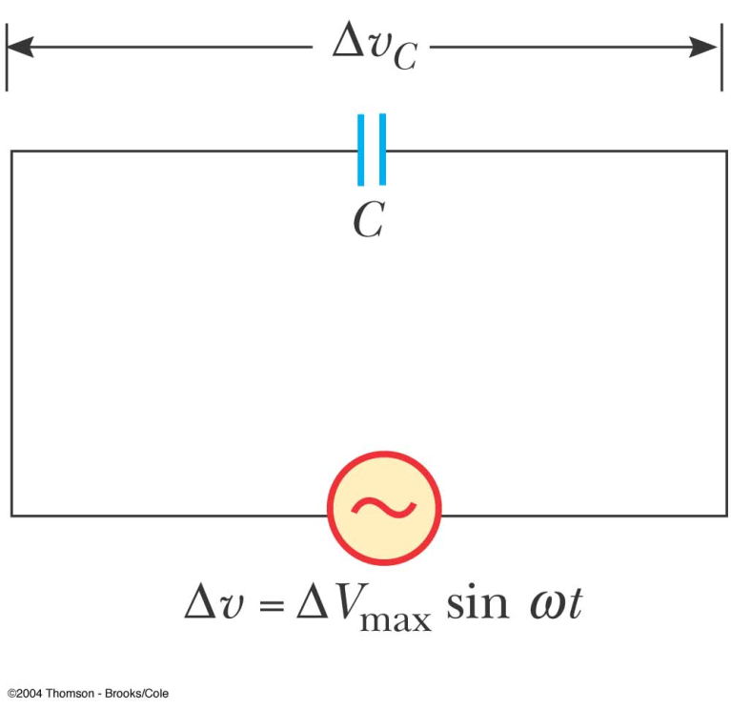
Capacitors in an AC Circuit
Consider a circuit containing a capacitor and an AC source
The current starts out at a large value and charges the plates of the capacitor
There is initially no resistance to hinder the flow of the current while the plates are not charged
As the charge on the plates increases, the voltage across the plates increases and the current flowing in the circuit decreases

Slide 34
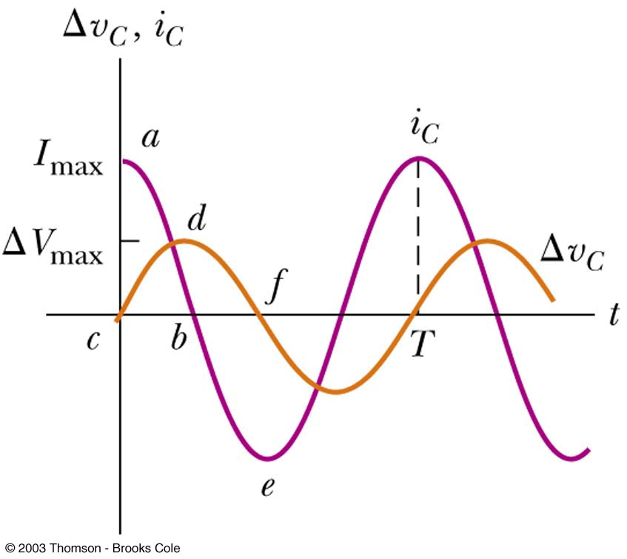

Slide 35

More About Capacitors in an AC Circuit
The current reverses direction
The voltage across the plates decreases as the plates lose the charge they had accumulated
The voltage across the capacitor lags behind the current by 90°

Slide 36
Capacitive Reactance and Ohm’s Law
The impeding effect of a capacitor on the current in an AC circuit is called the capacitive reactance and is given by
When ƒ is in Hz and C is in F, X_{C} will be in ohms
Ohm’s Law for a capacitor in an AC circuit
ΔV_{C,rms} = I_{rms} X_{C}

Slide 37

Capacitors in an AC Circuit
The circuit contains a capacitor and an AC source
Kirchhoff’s loop rule gives:
Δv + Δv_{c} = 0 and so
Δv = Δv_{C} = ΔV_{max} sin ωt
Δv_{c} is the instantaneous voltage across the capacitor

Slide 38
Capacitors in an AC Circuit, cont.
The charge is q = CΔV_{max} sin ωt
The instantaneous current is given by
The current is π/2 rad = 90º out of phase with the voltage

Slide 39
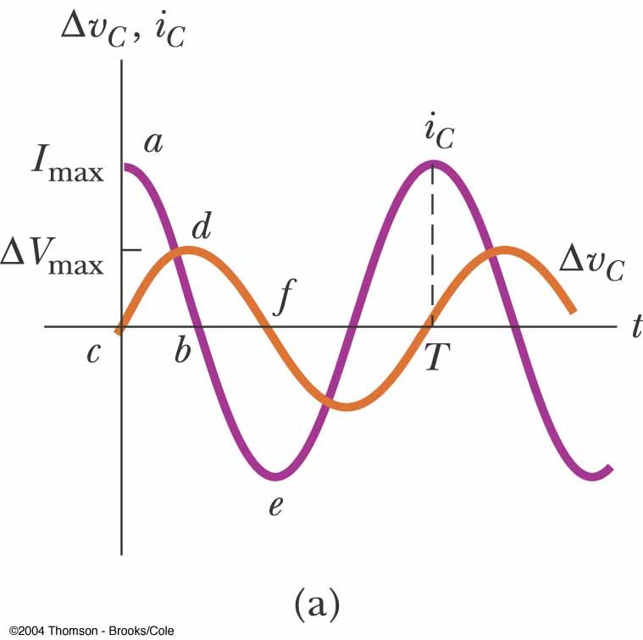
More About Capacitors in an AC Circuit
The current reaches its maximum value one quarter of a cycle sooner than the voltage reaches its maximum value
The voltage lags behind the current by 90º

Slide 40
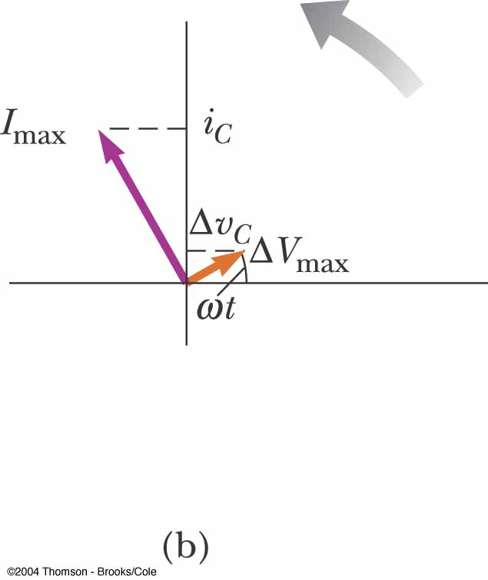
Phasor Diagram for Capacitor
The phasor diagram shows that for a sinusoidally applied voltage, the current always leads the voltage across a capacitor by 90º
This is equivalent to saying the voltage lags the current

Slide 41
Capacitive Reactance
The maximum current in the circuit occurs at cos ωt = 1 which gives
The impeding effect of a capacitor on the current in an AC circuit is called the capacitive reactance and is given by

Slide 42
Voltage Across a Capacitor
The instantaneous voltage across the capacitor can be written as
Δv_{C} = ΔV_{max} sin ωt = I_{max} X_{C} sin ωt
As the frequency of the voltage source increases, the capacitive reactance decreases and the maximum current increases
As the frequency approaches zero, X_{C} approaches infinity and the current approaches zero
This would act like a DC voltage and the capacitor would act as an open circuit

Slide 43
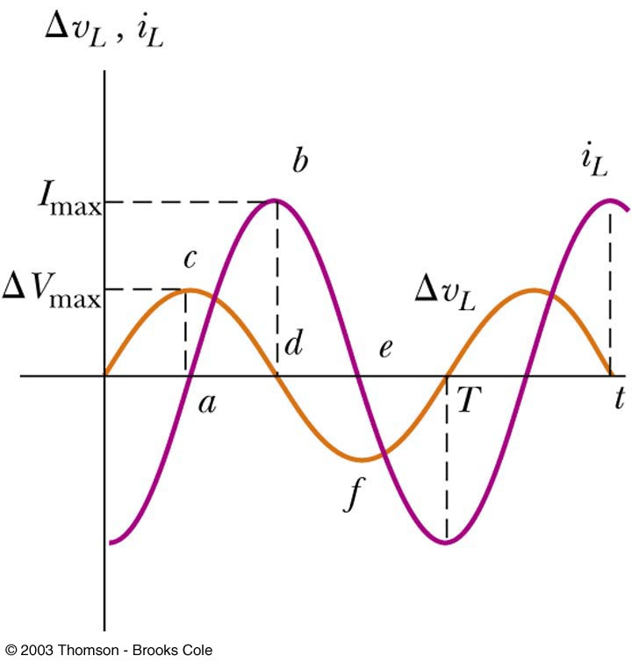
Inductors in an AC Circuit
Consider an AC circuit with a source and an inductor
The current in the circuit is impeded by the back emf of the inductor
The voltage across the inductor always leads the current by 90°

Slide 44
Inductive Reactance and Ohm’s Law
The effective resistance of a coil in an AC circuit is called its inductive reactance and is given by
X_{L} = 2πƒL
When ƒ is in Hz and L is in H, X_{L} will be in ohms
Ohm’s Law for the inductor
ΔV_{L,rms} = I_{rms} X_{L}

Slide 45
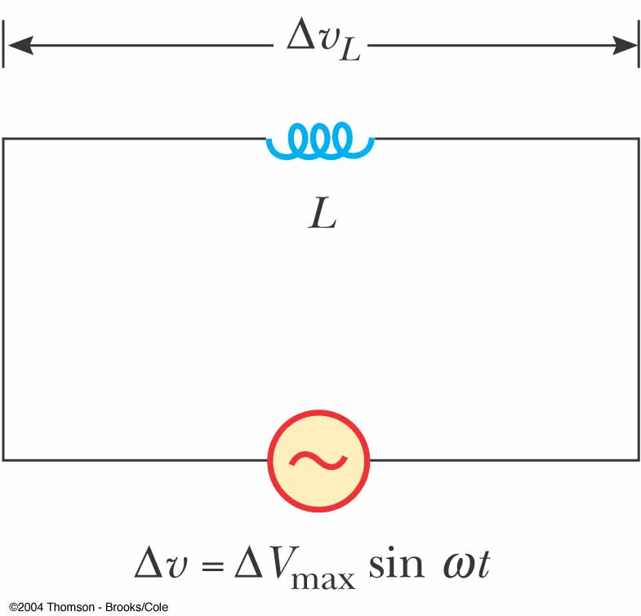
Inductors in an AC Circuit
Kirchhoff’s loop rule can be applied and gives:

Slide 46
Current in an Inductor
The equation obtained from Kirchhoff's fib can be solved for the current
This shows that the instantaneous current i_{L} in the inductor and the instantaneous voltage Δv_{L} across the inductor are out of phase by (π/2) rad = 90º

Slide 47
Phase Relationship of Inductors in an AC Circuit
The current in the circuit is impeded by the back emf of the inductor
For a sinusoidal applied voltage, the current in an inductor always lags behind the voltage across the inductor by 90° (π/2)

Slide 48
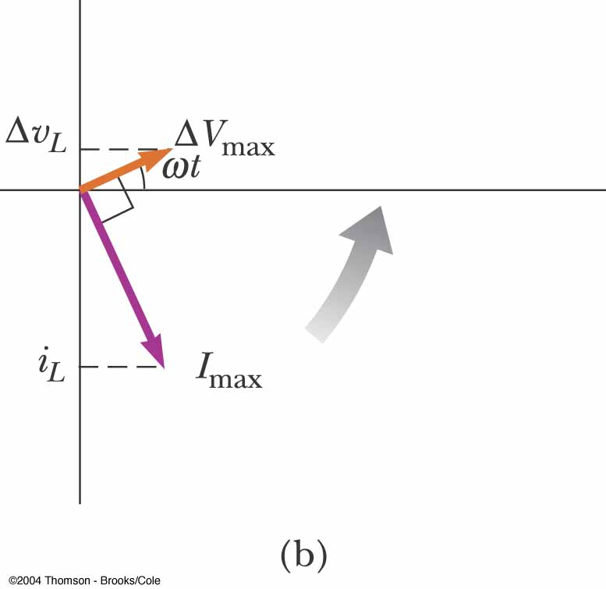
Phasor Diagram for an Inductor
The phasors are at 90º with respect to each other
This represents the phase difference between the current and voltage
Specifically, the current lags behind the voltage by 90º

Slide 49
Inductive Reactance
The factor ωL has the same units as resistance and is related to current and voltage in the same way as resistance
Because ωL depends on the frequency, it reacts differently, in terms of offering resistance to current, for different frequencies
The factor is the inductive reactance and is given by:
X_{L} = ωL

Slide 50
Inductive Reactance, cont.
Current can be expressed in terms of the inductive reactance
As the frequency increases, the inductive reactance increases
This is consistent with Faraday’s Law:
The larger the rate of change of the current in the inductor, the larger the back emf, giving an increase in the inductance and a decrease in the current

Slide 51
Voltage Across the Inductor
The instantaneous voltage across the inductor is

Slide 52
Lecture 28

Slide 53
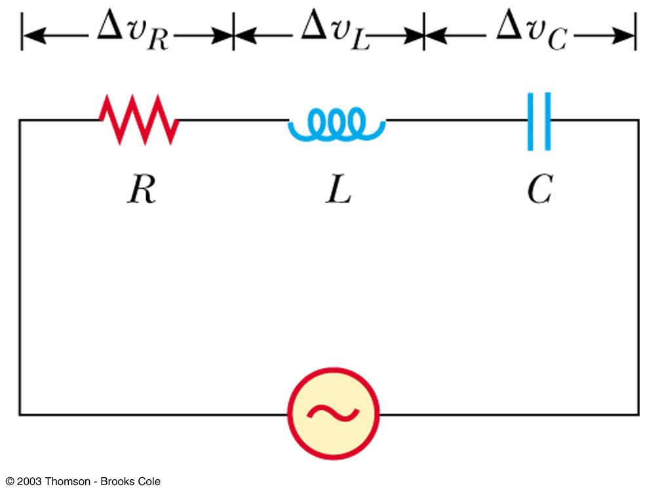
The RLC Series Circuit
The resistor, inductor, and capacitor can be combined in a circuit
The current in the circuit is the same at any time and varies sinusoidally with time

Slide 54
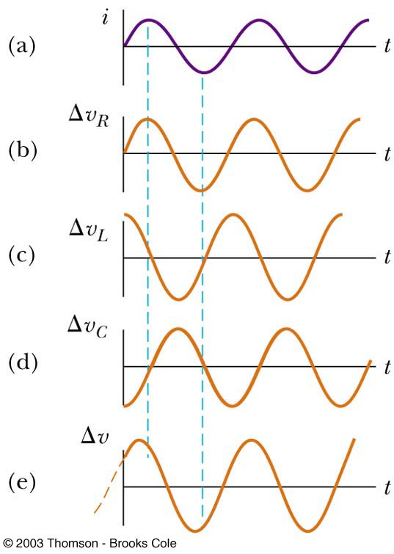
Current and Voltage Relationships in an RLC Circuit
The instantaneous voltage across the resistor is in phase with the current
The instantaneous voltage across the inductor leads the current by 90°
The instantaneous voltage across the capacitor lags the current by 90°

Slide 55
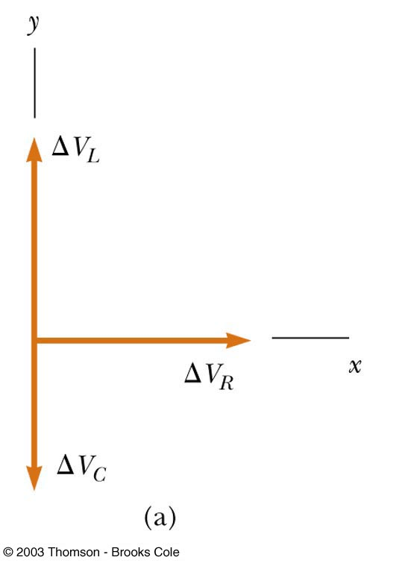
Phasor Diagram for RLC Series Circuit
The voltage across the resistor is on the +x axis since it is in phase with the current
The voltage across the inductor is on the +y since it leads the current by 90°
The voltage across the capacitor is on the –y axis since it lags behind the current by 90°

Slide 56
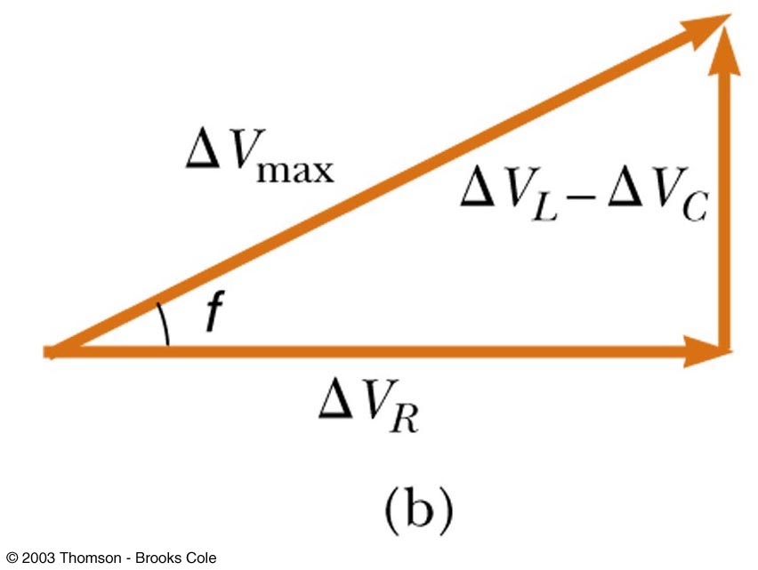
Phasor Diagram, cont
The phasors are added as vectors to account for the phase differences in the voltages
ΔV_{L} and ΔV_{C} are on the same line and so the net y component is ΔV_{L} - ΔV_{C}
ψ

Slide 57
ΔV_{max} From the Phasor Diagram
The voltages are not in phase, so they cannot simply be added to get the voltage across the combination of the elements or the voltage source
φ is the phase angle between the current and the maximum voltage
The equations also apply to rms values

Slide 58
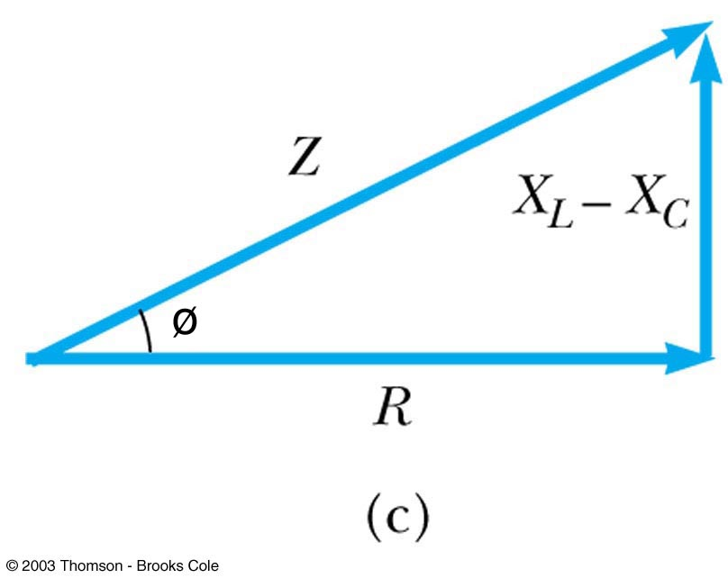
Impedance of a Circuit
The impedance, Z, can also be represented in a phasor diagram

Slide 59
Impedance and Ohm’s Law
Ohm’s Law can be applied to the impedance
ΔV_{max} = I_{max} Z
This can be regarded as a generalized form of Ohm’s Law applied to a series AC circuit

Slide 60
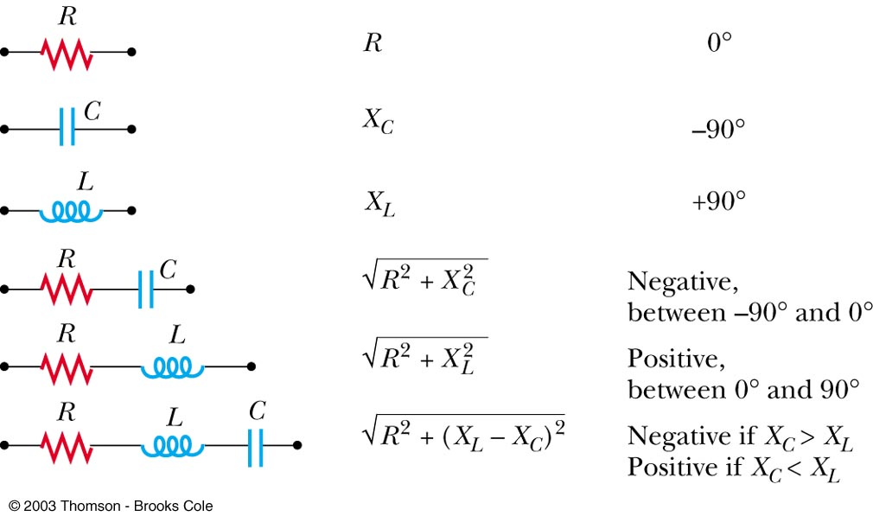
Summary of Circuit Elements, Impedance and Phase Angles
Elements Impedance (Z) Phase Angle ψ

Slide 61
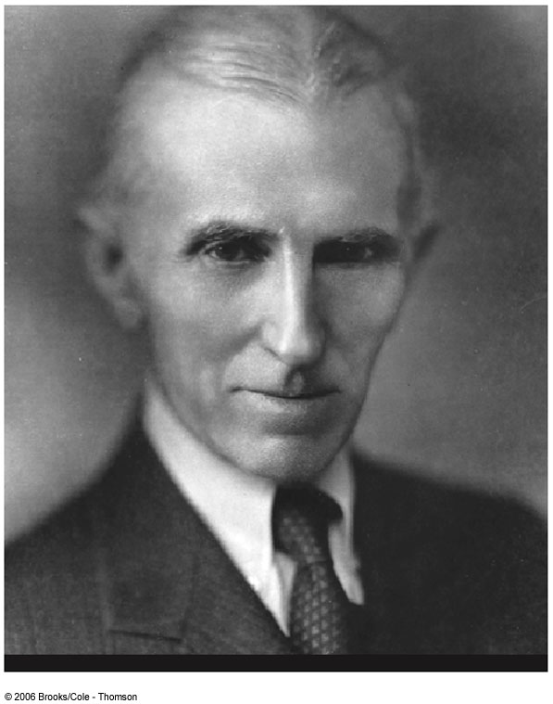
Nikola Tesla
1865 – 1943
Inventor
Key figure in development of
AC electricity
High-voltage transformers
Transport of electrical power via AC transmission lines
Beat Edison’s idea of DC transmission lines

Slide 62
Problem Solving for AC Circuits
Calculate as many unknown quantities as possible
For example, find X_{L} and X_{C}
Be careful of units – use F, H, Ω
Apply Ohm’s Law to the portion of the circuit that is of interest
Determine all the unknowns asked for in the problem

Slide 63
Power in an AC Circuit
ψ

Slide 64
Power in an AC Circuit
No power losses are associated with pure capacitors and pure inductors in an AC circuit
In a capacitor, during one-half of a cycle energy is stored and during the other half the energy is returned to the circuit
In an inductor, the source does work against the back emf of the inductor and energy is stored in the inductor, but when the current begins to decrease in the circuit, the energy is returned to the circuit

Slide 65
Power in an AC Circuit, cont
The average power delivered by the generator is converted to internal energy in the resistor
P_{av} = I_{rms}ΔV_{R} = I_{rms}ΔV_{rms} cos φ
cos φ is called the power factor of the circuit
Phase shifts can be used to maximize power outputs

Slide 66
Lecture 29

Slide 67
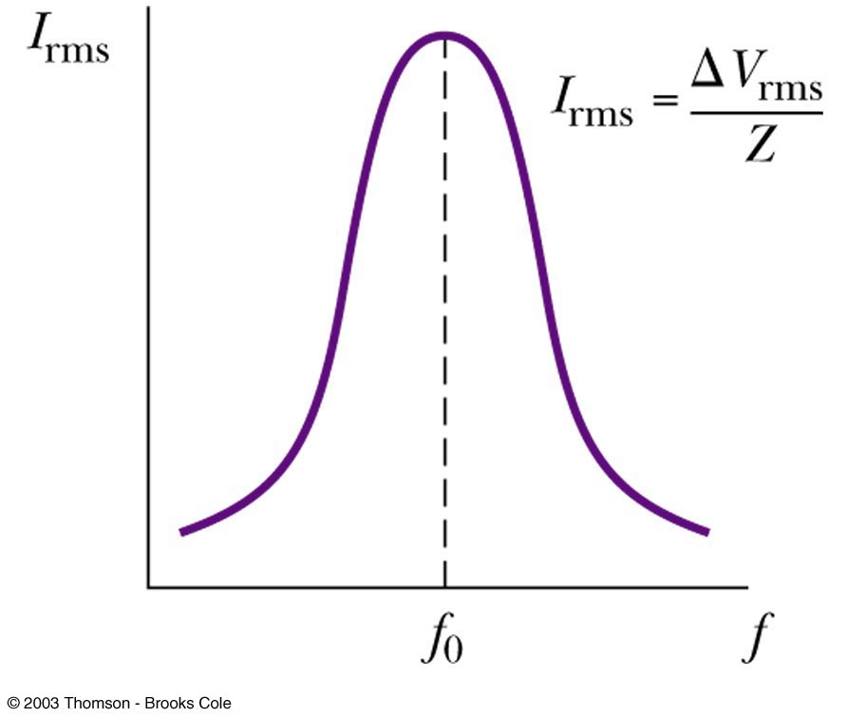
Resonance in an AC Circuit
Resonance occurs at the frequency, ƒ_{o}, where the current has its maximum value
To achieve maximum current, the impedance must have a minimum value
This occurs when X_{L} = X_{C}
Then,

Slide 68
Resonance, cont
Theoretically, if R = 0 the current would be infinite at resonance
Real circuits always have some resistance
Tuning a radio
A varying capacitor changes the resonance frequency of the tuning circuit in your radio to match the station to be received
Metal Detector
The portal is an inductor, and the frequency is set to a condition with no metal present
When metal is present, it changes the effective inductance, which changes the current
The change in current is detected and an alarm sounds

Slide 69
Resonance Example

Slide 70
Resonance Example

Slide 71
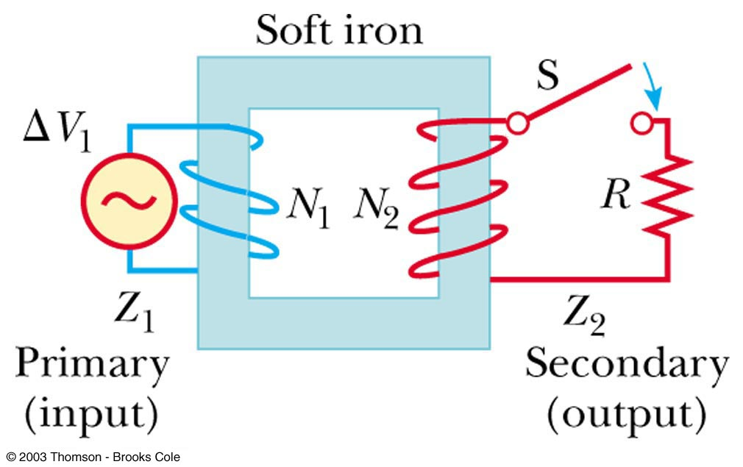
Transformers
An AC transformer consists of two coils of wire wound around a core of soft iron
The side connected to the input AC voltage source is called the primary and has N₁ turns

Slide 72
Transformers, 2
The other side, called the secondary, is connected to a resistor and has N₂ turns
The core is used to increase the magnetic flux and to provide a medium for the flux to pass from one coil to the other
The rate of change of the flux is the same for both coils

Slide 73
Transformers, 3
The voltages are related by
When N₂ > N₁, the transformer is referred to as a step up transformer
When N₂ < N₁, the transformer is referred to as a step down transformer

Slide 74
Transformer, final
The power input into the primary equals the power output at the secondary
I₁ΔV₁ = I₂ΔV₂
You don’t get something for nothing
This assumes an ideal transformer
In real transformers, power efficiencies typically range from 90% to 99%

Slide 75
Electrical Power Transmission
When transmitting electric power over long distances, it is most economical to use high voltage and low current
Minimizes I²R power losses
In practice, voltage is stepped up to about 230 000 V at the generating station and stepped down to 20 000 V at the distribution station and finally to 120 V at the customer’s utility pole

Slide 76
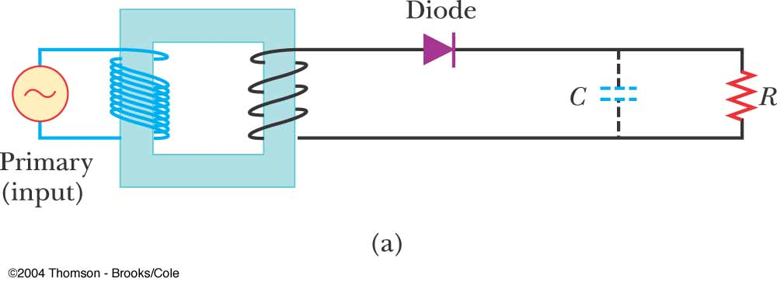
AC to DC conversion

Slide 77
“Dirty” DC current

Slide 78
Filtered DC Current

Slide 79
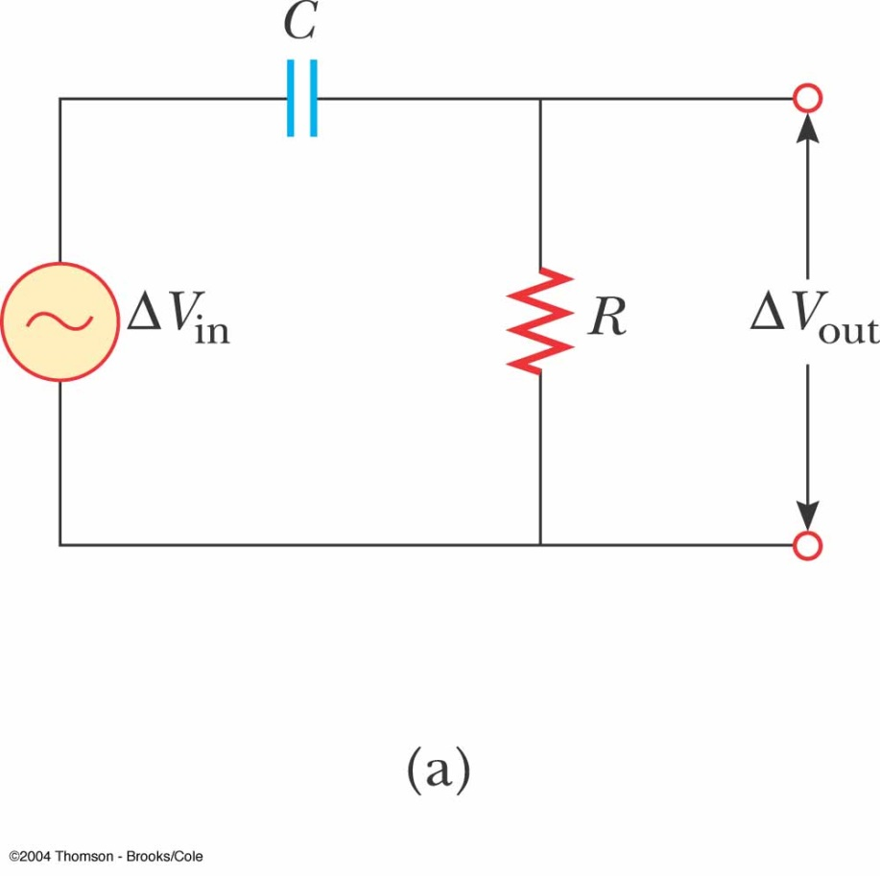
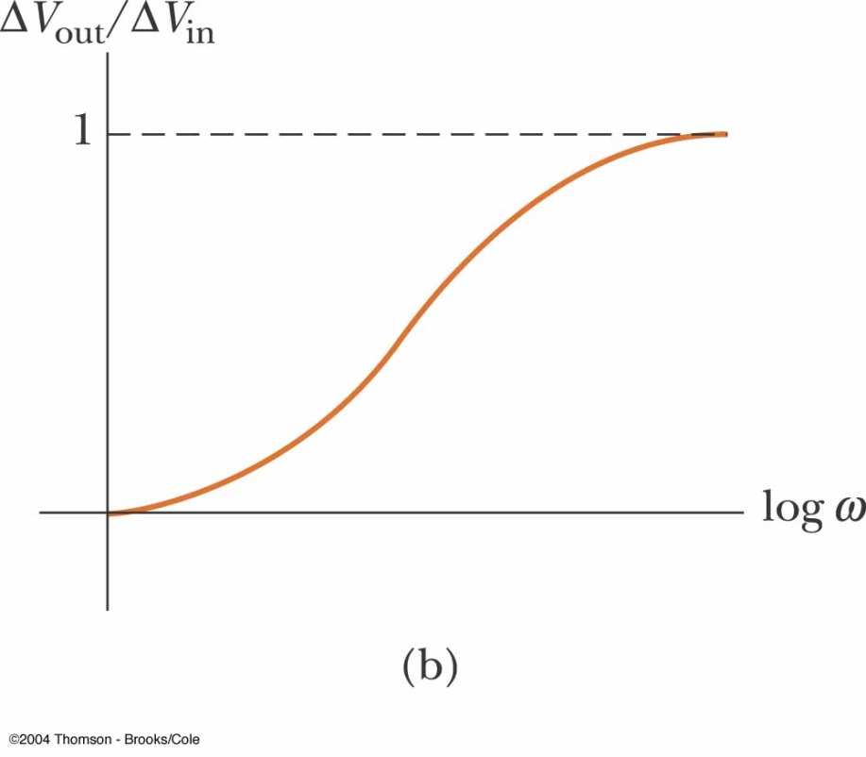
Hi Pass Filter

Slide 80
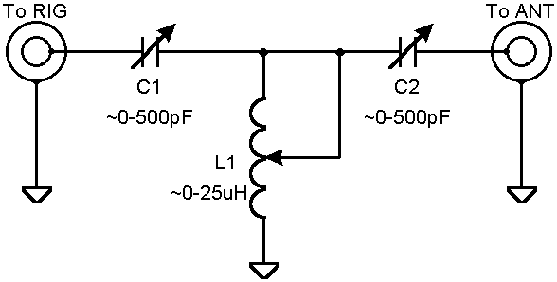
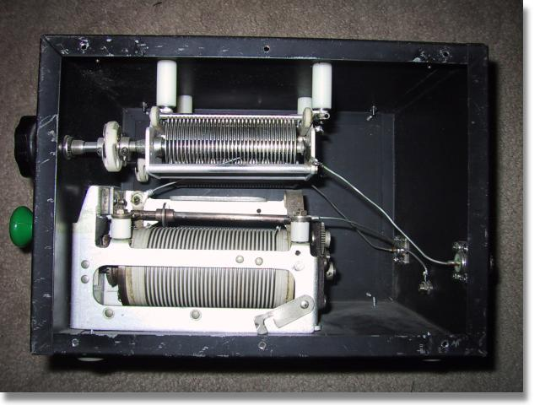
Antenna Tuner
http://www.aa5tb.com/tuner.html

Slide 81
Rectifier
ARRL General Class license Manual

Slide 82
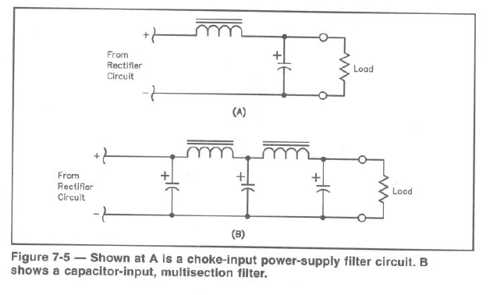
Power Filters
ARRL General Class license Manual

